Slide 1

VISVESVARAYA TECHNOLOGICAL UNIVERSITY “JNANASANGAMA”, BELAGAVI-590018
K R PETE KRISHNA GOVERNMENT ENGINEERING COLLEGE, KR PET-571426
2023-2024
Department of Computer Science & Engineering
Mini Project Presentation on
“Software-defined IDS with UAV Resource Aware Load-Balancing in FANET disaster scenarios”
Presenting By
PRAJWAL L G 4GK21CS031
USHA A M 4GK21CS051
VIKAS A V 4GK21CS054
RAKSHITHA 4GK22CS404
Under the Guidance of Head of the Department
Dr. Devika G Dr. Hareesh K
Assistant Professor Associate Professor & HOD
Dept. of CSE Dept. of CSE

Slide 2
CONTENTS
Abstract
Introduction
Literature Survey
Existing System
Problem Statement
Objectives
Advantages and Disadvantages
Conclusion
Reference

Slide 3
Abstract
In critical scenarios like natural disasters, the physical infrastructure of the network may be heavily damaged or completely torn down making difficult communications and rescue activities.
In such cases, due to their nature, Unmanned Aerial Vehicles (UAVs) are usually employed to provide a temporary support network by forming a Flying Ad-Hoc Network (FANET).
However, this network should be carefully monitored and safeguarded to guarantee its stability by deploying network security appliances, like Intrusion Detection Systems (IDSs).
In the wake of these considerations, The utilization of IDS functions deployed on UAVs, named IDS-enabled UAVs, in emergencies leveraging the modern Software-Defined Network (SDN) paradigm.

Slide 4
Introduction
Flying Ad-Hoc Networks (FANETs) with UAVs are crucial for real-time disaster response, enabling effective monitoring and communication.
These networks face challenges like dynamic topology, limited UAV resources, and security threats.
Integrating Software-Defined Networking (SDN) and machine learning offers centralized, adaptable threat detection and mitigation.
This project presents an SD-IDS with resource-aware load-balancing to enhance FANET security and efficiency in disaster scenarios.

Slide 5
Literature Survey
FANETs in Disaster Scenarios: Studies highlight the critical role of FANETs in disaster management, emphasizing their capabilities in real-time monitoring and communication establishment.
Intrusion Detection Systems (IDS) in FANETs: Research indicates the necessity of robust IDS to protect FANETs from security threats.
Software-Defined Networking (SDN): SDN's centralized control and flexibility are shown to enhance network security and adaptability.
Load-Balancing in UAV Networks: Prior work on load-balancing algorithms demonstrates the importance of resource-aware traffic distribution to optimize UAV performance and extend network longevity.

Slide 6
Existing System
Existing systems for IDS in FANETs often rely on decentralized approaches with limited adaptability to dynamic disaster scenarios.
Current load-balancing strategies in UAV networks typically lack resource-awareness, leading to suboptimal distribution of network traffic.
Some research integrates machine learning for intrusion detection but lacks SDN's centralized control and adaptability.
Overall, existing systems face challenges in efficiently securing and optimizing UAV resources in dynamic disaster scenarios.

Slide 7
Problem Statement
Introduce on problem, The “Software defined IDS with UAV Resource Aware Load balancing in FANET disaster scenario”, solution for this Develop a software-defined IDS with UAV resource-aware load balancing in FANETs to optimize security and efficiency in disaster response scenarios.

Slide 8
System Design
System Components:
1. SD-IDS (Software-Defined Intrusion Detection System):
- Network Traffic Monitoring
- Threat Detection Engine
- Policy Enforcement Module
2. UR-ALB (UAV Resource-Aware Load Balancer):
- Resource Monitoring Module
- Load Balancing Module
3. FANET Management:
UAV Management Module
Resource Allocation Module
4. Data Storage:
- Database for storing network traffic data, threat intelligence, and system configuration

Slide 9
Implementation
import matplotlib.pyplot as plt
import numpy as np
# Data
strategies = ['Random LB', 'Round Robin LB', 'S_URA LB']
dynamic = [15.9, 16.2, 20.2]
static = [12.5, 14.3, 17.3]
x = np.arange(len(strategies)) # the label locations
width = 0.35 # the width of the bars
fig, ax = plt.subplots()
rects1 = ax.bar(x - width/2, dynamic, width, label='Dynamic', color='blue')
rects2 = ax.bar(x + width/2, static, width, label='Static', color='orange')
# Add some text for labels, title and custom x-axis tick labels, etc.
ax.set_ylabel('Time [min]')
ax.set_title('Battery autonomy comparison under Static and Dynamic Deployment')
ax.set_xticks(x)
ax.set_xticklabels(strategies)
ax.legend()

Slide 10
Cntd….
# Add annotations
def autolabel(rects):
"""Attach a text label above each bar in rects, displaying its height."""
for rect in rects:
height = rect.get_height()
ax.annotate('{}'.format(height),
xy=(rect.get_x() + rect.get_width() / 2, height),
xytext=(0, 3), # 3 points vertical offset
textcoords="offset points",
ha='center', va='bottom')
autolabel(rects1)
autolabel(rects2)
fig.tight_layout()
plt.show()

Slide 11
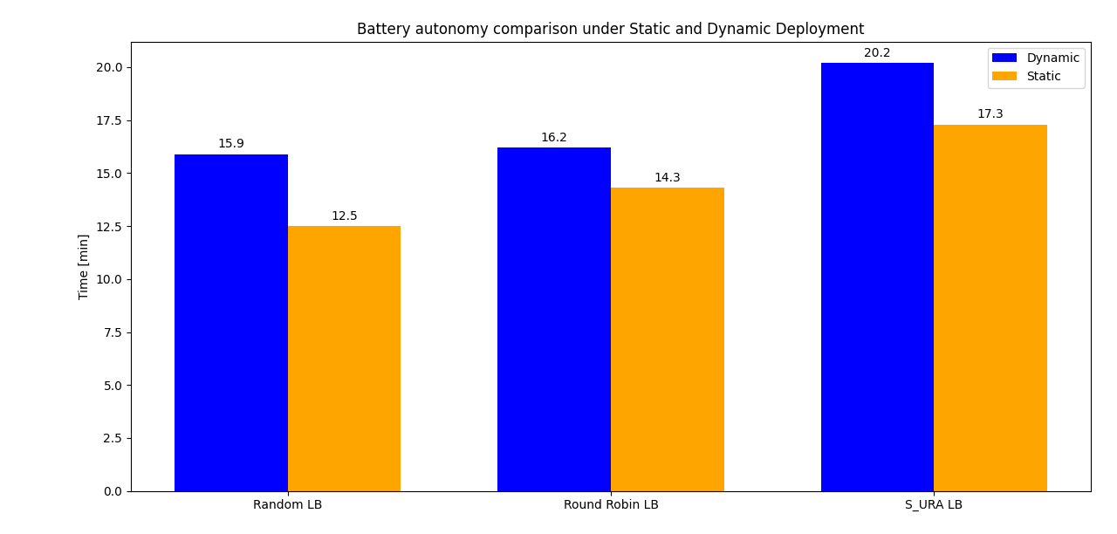
The bar chart compares battery autonomy under static and dynamic deployment using three load balancing (LB) strategies: Random, Round Robin, and S_URA. Dynamic deployment consistently shows higher battery autonomy than static deployment. The S_URA LB strategy yields the highest autonomy, with dynamic deployment reaching 20.2 minutes.

Slide 12
Objectives
Design a Software-Defined Intrusion Detection System (SD-IDS): Enable real-time monitoring, detection, and response to security threats.
Implement Resource-Aware Load Balancing Mechanisms: Design a dynamic load balancing strategy to maintain network performance and extend UAV operational life under high load conditions.
Integrate SD-IDS with Resource-Aware Load Balancing: Seamlessly combine SD-IDS with the load balancing mechanism for enhanced security and efficiency.

Slide 13
Advantages
Enhanced Security
Optimized Resource Utilization
Adaptability
Reduced Operational Costs
Enhanced Coverage and Responsiveness

Slide 14
Disadvantages
Complexity
Dependency on Connectivity
Expensive
Resource Overhead

Slide 15
CONCLUSION
The integration of Software-defined IDS with UAV resource-aware load-balancing presents a promising solution for enhancing FANET resilience in disaster scenarios. It offers improved security through centralized control and dynamic threat response. Efficient resource utilization prolongs network operation, while advancements in machine learning bolster intrusion detection accuracy. Future efforts should prioritize refining implementation complexities and mitigating potential security vulnerabilities to realize its full potential in critical disaster response operations.

Slide 16
REFERENCES
D. Kreutz, F.M. Ramos, P.E. Verissimo, C.E. Rothenberg, S. Azodolmolky, S.Uhlig, Software-defined networking: A comprehensive survey, Proc. IEEE 103 (1) (2014) 14–76.
F. Al-Turjman, M. Abujubbeh, A. Malekloo, L. Mostarda, UAVs assessment in software-defined IoT networks: An overview, Comput. Commun. 150 (2020)519–536.
H. Zhong, Y. Fang, J. Cui, Reprint of ‘‘LBBSRT: An efficient SDN load balancing scheme based on server response time’’, Future Gener. Comput. Syst. 80 (2018) 409–416, http://dx.doi.org/10.1016/j.future.2017.11.012.
I.T. Singh, T.R. Singh, T. Sinam, Server load balancing with round robin technique in SDN, in: 2022 International Conference on Decision Aid Sciences and Applications, DASA, 2022, pp. 503–505, http://dx.doi.org/10.1109/DASA54658.2022.9765287.

Slide 17
Thank You…

